Slide 1
The Digital Single Market Copyright Directive Proposal and beyond: Towards a ‘toolbox’ for future European Copyright Law GRUR meets Brussels Workshop 2017
FAIR REMUNERATION IN CONTRACTS
OF AUTHORS AND PERFORMERS
The role and regulation of claims to fair compensation
Brussels, June 12, 2017
Reto M. Hilty

Slide 2
I Remuneration – an item of the “toolbox”?
remuneration…?
EU copyright contract law!

Slide 3
The role and regulation of claims to fair compensation
I Remuneration – an item of the “toolbox”?
II EU competence?
III Subject matter of regulation?
IV Is there common ground?
V What is “fair” remuneration?
VI “Remuneration” – or “compensation”
VII Next steps forward?

Slide 4
II EU competence?
Contract law ■ no general competence
■ limited competence in specific fields
(e.g. consumer protection)
■ competence substantive copyright law
≠ competence copyright contract law
■ “functional” competence
(= measure to establish Internal Market)
→ shared competence
→ status quo (e.g. InfoSoc Directive)
Unitary copyright contract law

Slide 5
The role and regulation of claims to fair compensation
I Remuneration – an item of the “toolbox”?
II EU competence?
III Subject matter of regulation?
IV Is there common ground?
V What is “fair” remuneration?
VI “Remuneration” – or “compensation”
VII Next steps forward?

Slide 6
III Subject matter of regulation?
Concerns ■ remuneration of authors / performers
■ balance of interests of parties involved
■ business models in digital environment
Copyright contract law → numerous other issues, like
→ transferability of copyright law as such
monistic approach
± work made for hire
▪ not transferable
▪ continuing relationship
▪ correction of imbalance
▪ author ≠ right holder
▪ buy out contract
▪ foundation for correction?

Slide 7
The role and regulation of claims to fair compensation
I Remuneration – an item of the “toolbox”?
II EU competence?
III Subject matter of regulation?
IV Is there common ground?
V What is “fair” remuneration?
VI “Remuneration” – or “compensation”
VII Next steps forward?

Slide 8
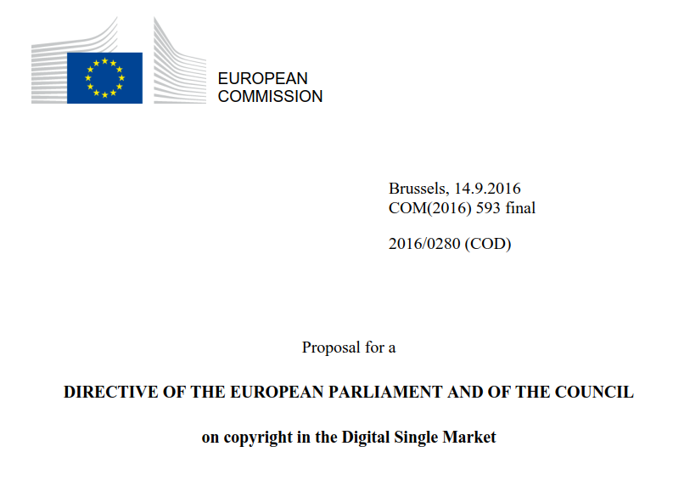
IV Is there common ground?
D

Slide 9
The role and regulation of claims to fair compensation
I Remuneration – an item of the “toolbox”?
II EU competence?
III Subject matter of regulation?
IV Is there common ground?
V What is “fair” remuneration?
VI “Remuneration” – or “compensation”
VII Next steps forward?

Slide 10
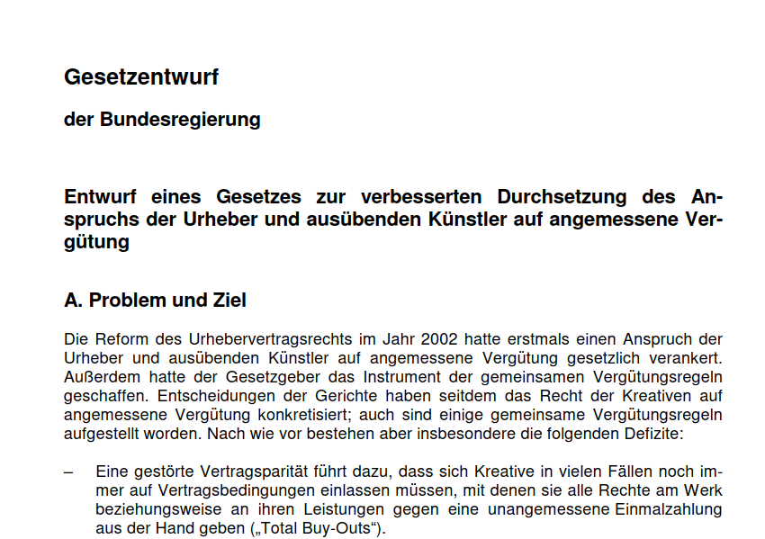
IV What is “fair” remuneration?
D
Structural problems of creative markets:
“suppliers” > ^{“buyers”}

Slide 11
The role and regulation of claims to fair compensation
I Remuneration – an item of the “toolbox”?
II EU competence?
III Subject matter of regulation?
IV Is there common ground?
V What is “fair” remuneration?
VI “Remuneration” – or “compensation”
VII Next steps forward?

Slide 12
VI “Remuneration” – or “compensation”?
Copyright contract law Collective rights management
■ 1965: legalization of private copying
■ digital world: what is “liability approach”?
▪ legalized uses?
▪ players enabling uses?
▪ price system?
▪ collection/distribution system?
→ beneficiaries?

Slide 13
VI “Remuneration” – or “compensation”?
CJEU, C-572/13 (Hewlett-Packard Belgium SPRL/13 vs. Reprobel SCRL)
CJEU, C-245/00
(Stichting…)
value of use of work
Art. 5 Rental-Dir 2006/115:
“equitable remuneration”
FAIR REMUNERATION IN CONTRACTS
OF AUTHORS AND PERFORMERS
The role and regulation of claims to fair compensation
creator/performer ?
CJEU, C-167/08 (Padawan…)
harm suffered by
right holder
Art. 5 InfoSoc-Dir 2001/29:
“fair compensation”

Slide 14
The role and regulation of claims to fair compensation
I Remuneration – an item of the “toolbox”?
II EU competence?
III Subject matter of regulation?
IV Is there common ground?
V What is “fair” remuneration?
VI “Remuneration” – or “compensation”
VII Next steps forward?

