Slide 1
Patentability of AI related inventions
The EPO perspective
Dr Argyrios Bailas / Dr Doris Thums
5 June 2018

Slide 2
Definition of Artificial Intelligence (AI)
Artificial Intelligence (AI) encompasses methods, systems and devices that exhibit behaviours perceived as intelligent by humans, such as learning, reasoning, inferring and making decisions
An example is Machine Learning (ML), which gives a machine the ability to change according to experience gained by the machine itself. Implementations of AI/ML often fall under the definition of Computer-Implemented Inventions (CII)
Neither AI nor ML are defined in the EPC

Slide 3
EPO applications in core AI
Source: EPO. The number of European patent applications in core AI technologies corresponds to EP/WO families in the CPC classes G06N7, G06N5, G06N99 and G06N3. The number of European patent applications related to AI is derived from a full text search for related machine learning terminology in a corpus of EP/WO families. The results are presented by oldest priority date.

Slide 4
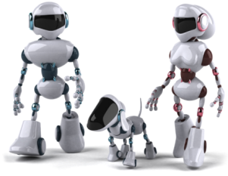
Application of AI
Information retrieval, databases
Bioinformatics
Speech recognition
Intelligent robots (behaviour, humanoids)
Network management based on AI

Slide 5
What is AI – how do machines learn?
N
neural networks
discriminant analysis
genetic algorithms
machine learning
rule-based systems
fuzzy logic
expert knowledge

Slide 6
Patentability requirements
Art. 52(1) EPC
Inventions in all fields of technology
New
Inventive
Patentability of AI and ML
Art. 52(2) and (3) EPC
Mathematical methods, schemes, rules and methods for performing mental acts etc. are not regarded as inventions
if claimed as such in the application
Art. 54 and 56 EPC
All features contributing to the technical character are taken into account for the assessment of inventive step of an invention in the field of AI and ML

Slide 7
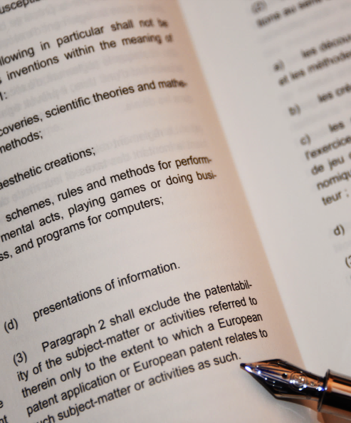
Patents for AI under the EPC?
Mathematical methods cannot be patented "as such"
Two short words which have generated
a large body of case law and extensive
amendments to the Guidelines
But which have resulted in a stable European approach

Slide 8
Exceptions to the exclusions from patentability
As with CII, patents on AI and ML may be granted if the invention is
not purely an abstract or intellectual concept
implemented by using a computer, computer network or other programmable apparatus with technical effect
of a technical character

Slide 9
Key issues – how to describe such inventions?
Clarity
in claim drafting and the description of the matter for which protection is sought care should be taken regarding the terms used
common understanding of specific terminology cannot always be assumed
Sufficiency of disclosure
an invention has to be described sufficiently clearly and completely to be carried out by a person skilled in the art

Slide 10
Key issues – who is the inventor?
No definition in patent law
Uniform understanding that it is a natural person
author who performed the creative act has moral rights to be acknowledged and mentioned
substantive right to the invention

Slide 11
Key issues – AI and inventorship
Can AI be the inventor?
Can an invention be seen as wholly generated by AI without human intervention?
Is it important who triggered the process?

Slide 12
Key issues – person skilled in the art
An application shall disclose the invention in a manner for it to be carried out by a person skilled in the art
An invention shall not be obvious to a person skilled in the art
Effect of AI and ML
inventions involving AI or ML may raise the level of skills and knowledge of the skilled person and thus the level of inventive step required

Slide 13
Is there a need to adapt the definition of a skilled person?
Projects attempting algorithmically
to create and to publish all possible new prior art
thereby making the published concepts non-patentable
Plurality of persons with the knowledge from the respective fields of the application
skilled practitioners having means of AI and ML available

Slide 14
Opportunities and challenges
Three key areas
AI finds prior art, invents and drafts patents
APPLICANTS AND SERVICES
PATENT OFFICES
AI as a computer- implemented invention
PATENT LEGAL SYSTEM
AI
AI processes patents and assists decision-making
§§

Slide 15
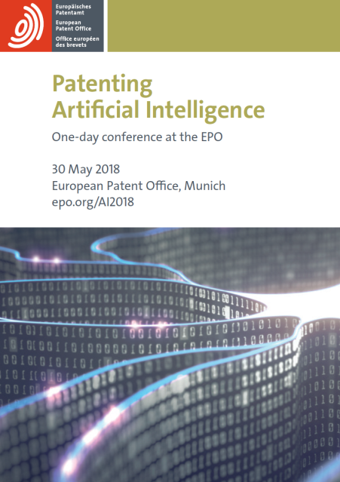
EPO Conference “Patenting AI” - 30 May 2018, Munich
Tackling issues relating to patenting of AI
Impact on the global economy
Patentability of AI at the EPO, and internationally
Ethical and societal issues

Slide 16
EPO Conference “Patenting AI” – main issues
AI is part of CII
Inventions based on algorithms patentable
if not claimed as such
No legislative change necessary
How to determine entitlement if the invention was created by AI?
Drafting claims avoiding “black box”
Disclosure of the invention in the description is essential

Slide 17
www.epo.org
Thank you for your attention!

