Slide 1
AI – an industry perspective
And some thoughts on copyright
Daniel Schönberger
Brussels, 5 June 2018

Slide 2
Overview
Some terms and definitions
The technology
Key challenges
Upstream questions
Use of copyrighted material for machine learning
A use case
AI downstream creations
Philosophical and legal foundations

Slide 3
artificial intelligence
science of making things smart
machine learning
techniques to learn from data

Slide 4
A different way of doing things
Write a computer program with explicit rules to follow
if email contains V!agrå
then mark is-spam;
if email contains …
if email contains …
Write a computer program to learn from examples
try to classify some emails;
change self to reduce errors;
repeat;

Slide 5
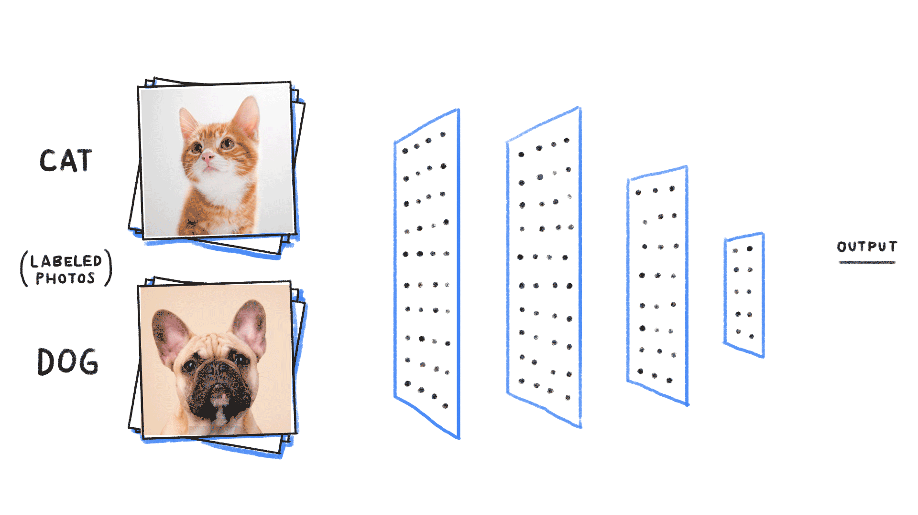
Deep Neural Networks Step 1: training

Slide 6
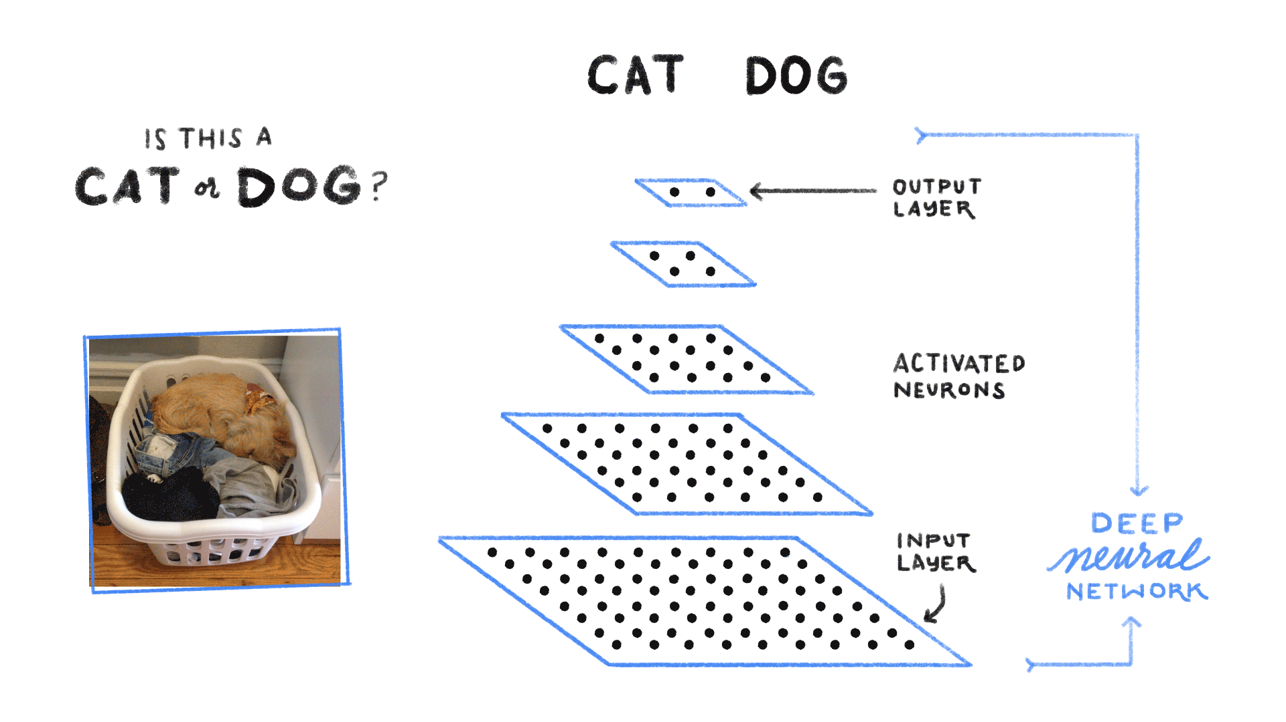
Deep Neural Networks Step 2: testing

Slide 7
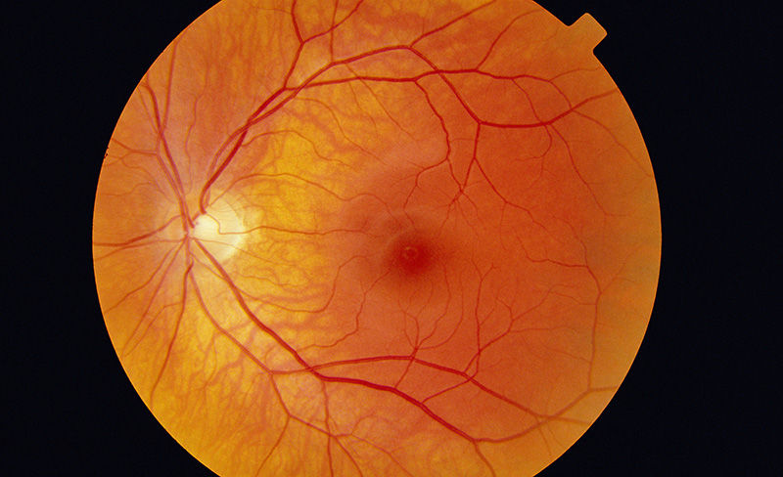
© Paul Parker/SPL

Slide 8
Some key challenges
Explainability
Accountability
Fairness
Inclusion
Safety
Liability
Copyright

Slide 9
Explainability, accountability, fairness, inclusion
Algorithmic “black boxes”
"Garbage in garbage out”
Risk of (hidden) bias and discrimination
Moral responsibility
Highly researched field
Algorithms can help to detect bias in human decisions
Need for high quality open data sets
Diversity in development
Google ML Fairness initiatives, PAIR, Facets

Slide 10
Safety and liability
Automation, connectivity, autonomy
Alleged unpredictability and opacity
Burden of proof
Alleged new ontological quality of AI systems
What is really new?
Are the underlying assumptions correct?
Horizontal vs. vertical regulation
Personhood for robots, really?

Slide 11
Copyright: Upstream

Slide 12
“It doesn’t harm the authors and is done for a very different purpose from the authors’, so it’s fair use under US law.”
(Google spokesman)
“blatantly commercial use of expressive authorship”
(Authors Guild)
https://www.theguardian.com/books/2016/sep/28/google-swallows-11000-novels-to-improve-ais-conversation

Slide 13
Non-expressive use
Copy-reliant technology
Copyright “doctrine of public places”
No communication to the public, no expressive substitution
Building blocks of language are public domain
Fair use
Reproduction a legal (not technical) notion
No economic exploitation, no reproduction (CJEU Football Association Premier League)
Mere copy should not be trigger for copyright

Slide 14
Copyright: Downstream

Slide 15
What is creativity and can it be coded?
Creativity as the touchstone of copyright protection (Feist, Infopaq)
Creativity involves e.g. “fruits of intellectual labor”, “expression of a thought”, “individual traits”, “originality”
Novelty and usefulness, fluency, flexibility, originality and elaboration, response uniqueness
Correlation between creativity and intelligence
Intrinsically human?
Or patterns, behaviors, traits?
Turing Test vs. Chinese Room Gedankenexperiment

Slide 16
https://www.nextrembrandt.com/

Slide 17
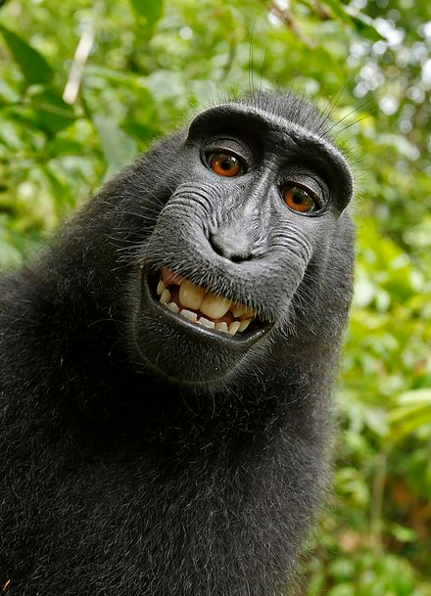
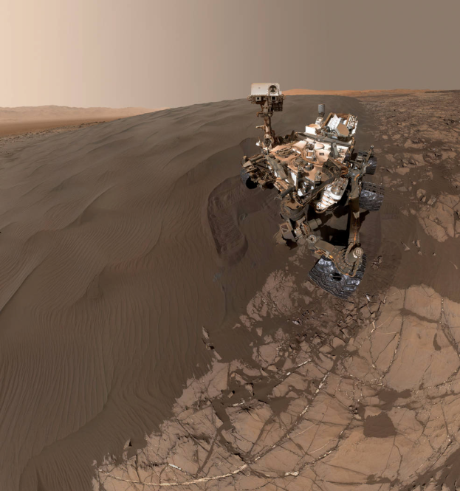
https://en.wikipedia.org/wiki/Monkey_selfie
https://www.nasa.gov/feature/jpl/sandy-selfie-sent-from-nasa-mars-rover

Slide 18
COPYRIGHT?
http://www.simonandschuster.com/books/Do-Androids-Dream-of-Electric-Sheep-Omnibus/various/Do-Androids-Dream-of-Electric-Sheep/9781608867844

Slide 19
Thank you

Slide 20
References and further readings part 1
EC Communication on Artificial Intelligence, 2018 (here).
EC Staff Working Document on Liability, 2018 (here).
European Parliament, Committee on Legal Affairs, Report with recommendations to the Commission on Civil Law Rules on Robotics, 2017 (here).
McCarthy J, What is Artificial Intelligence? Stanford University, 12 November 2007 (here).
Schönberger D, Deep Copyright: Up- and Downstream Questions Related to Artificial Intelligence (AI) and Machine Learning (ML), Zeitschrift für Geistiges Eigentum / Intellectual Property Journal, Volume 10, Number 1, March 2018, pp. 35-58(24) (free access to earlier version here).

Slide 21
References and further readings part 2
Searle JR, Minds Brains, and Programs, The Behavioral and Brain Science 3 (3), 1980, pp. 417-457 (here).
Turing A, Computing, machinery and intelligence, Mind, 49, 1950, pp. 433-460 (here).
Zunger Y, Asking the Right Questions About AI, 12 October 2017 (here).

