Slide 1
Artificial Intelligence for Europe GRUR Workshop "AI, robotics and IP – What's at stake?"
Bjoern Juretzki
Assistant to the Director-General – DG CONNECT

Slide 2
Artificial Intelligence today
Various fields of applications
Impact of AI on society and our daily lives
Exponential growth of computing power combined with availability of increasing amounts of data
Advances in algorithms: machine learning, deep learning

Slide 3
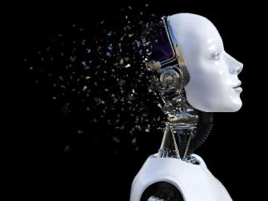
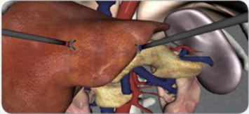
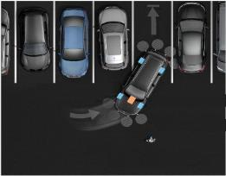
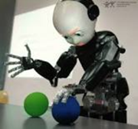
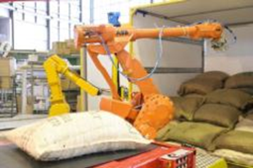
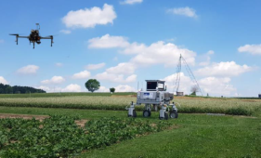
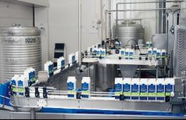
Europe has strong assets
World-leading position in robotics, especially for professional users
Performant industrial and services sectors & strong business-to-business applications
World-leading research centers

Slide 4
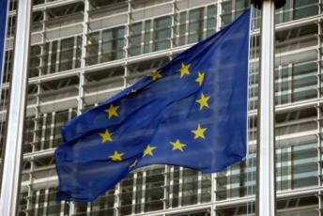
Political context
Resolution on civil law rules on robotics from European Parliament [2016]
Opinion of the European Economic and Social Committee – Artificial intelligence [2017]
European Council asked EC to prepare a European approach to AI [October 2017]
Activities within the EU (France, Finland, …) and outside (USA, China, …)

Slide 5
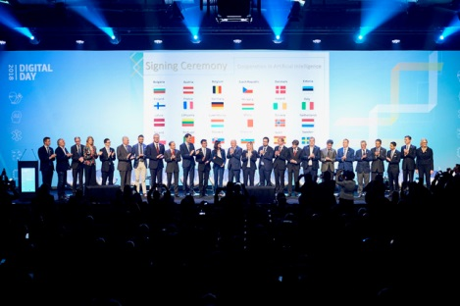
Digital Day on 10th April
Goal: Committing EU MS to cooperate on AI together
Declaration covers funding, ethical and legal issues, labour market, etc
24 EU MS plus Norway signed declaration to cooperate more closely
Coordinated plan by the end of the year

Slide 6
Artificial Intelligence for Europe
SWD(2018) 137 – published 25/04/2018
STRATEGY FOR EUROPE TO LEAD THE WAY
Boosting technological and industrial capacity –
AI uptake
Prepare for socio-economic changes
Ensure an appropriate ethical
and legal framework
Development and use of
AI for good and for all

Slide 7
The European AI Alliance
Joint reflection on the future of AI in Europe
Full mobilisation of all stakeholders needed: industry, academia, civil society
Goal: Making it the world-wide reference platform for thinking and reflection on AI
Supported by high-level expert group on AI and an online platform

Slide 8
Monitoring and international outreach
Monitor the uptake of AI across the economy and the impact on the labour market
Benchmark the technical capabilities of AI to provide a realistic understanding of where the technology stands
Continue working with international fora such as the OECD, G7, G20 and the UN and Europe's bilateral partners (Japan, etc.) on AI

Slide 9
Boosting the EU's technological and industrial capacity: 2018 - 2020
Support for basic (explainable AI, data-efficient AI) and industrial research (health, transport, agriculture, manufacturing)
AI-on-demand platform
Network of AI-focused Digital Innovation Hubs (DIHs)
Strengthening AI excellence centres
€1.5 billion EC investments into AI in 2018-20
Notes:
€1.5 billion: 70% increase compared to previous period on an annualised basis
Transport: autonomous ship
Healthcare: AI to improve cancer treatment

Slide 10
Boosting the EU's technological and industrial capacity: beyond 2020
Overarching goal: Increasing the investments into AI from currently €4-5 billion per year to €20 billion per year in the 2020s
An ambitious proposal to support AI in the period 2021-27
Basic and application-oriented research
AI excellence centres and DIHs
Supporting the establishment of world-leading testing and experimentation sites
Notes:
€1.5 billion: 70% increase compared to previous period on an annualised basis
Transport: autonomous ship
Healthcare: AI to improve cancer treatment

Slide 11
Making more data available
An updated Directive on public sector information
Guidance on sharing private sector data in the economy (including industrial data)
An updated Recommendation on access to and preservation of scientific information
A Communication on the digital transformation of health and care, including sharing of genomic and other health data sets
Notes:
PSI: traffic, meteorological, economic and financial data or business registers;

Slide 12
Preparing for socio-economic changes
Set up dedicated (re-)training schemes in connection with the Blueprint on sectoral cooperation on skills
Gather input from experts to anticipate changes on the labour market
Support Digital Opportunity Traineeships (2018-20) in advanced digital skills for students and fresh graduates
Ask social partners to include AI in their joint work programmes
Ask the European Institute of Innovation and Technology to integrate AI in their education offerings
Consider broadening the scope of the current European Globalisation Adjustment Fund to digitisation/automation

Slide 13
Ensuring an appropriate ethical and legal framework
Develop draft AI ethics guidelines by the end of the year
Issue a guidance document on the interpretation of the Product Liability Directive by mid-2019
Publish a report on the broader implications of AI for the liability and safety frameworks
Support the development of explainable AI
Implement a pilot project on Algorithmic Awareness Building

Slide 14
AI and IP: Artificial creativity

Slide 15
AI and IP: Artificial creativity
"Robot scientist helps discover new ingredient for anti-malarial drug"
"AI is rewriting the TV script"
"Aiva is the first AI to officially be recognised as a composer"
"Virtual Bach: Experiments in musical intelligence"
AlphaGo vs. Lee Sedol: Game 2, move 37 considered to be "so surprising that it overturned hundreds of years of received wisdom"
Notes:
- Robot scientist: ability to make observations, devise hypotheses, design experiments to test hypotheses, employ automated laboratory equipment to run those experiments, and interpret the results

Slide 16
AI and IP
Human intuition and ingenuity vs. brute force of computing power
Patentability: Novelty and inventive step/invention not obvious
Does the concept of "obviousness" need to be redefined?
Patentable concept is a "mental creation by a human being" – are inventions of autonomous computers patentable?
Action: Launching a study on how AI impacts the IP framework

Slide 17
Conclusion
Guiding principle: Placing the power of AI at the service of Europeans (human-centric AI)
Unique European approach to AI providing an integrated perspective
Supported by EU AI Alliance
AI and IP: More questions than answers!

